Slide 1

NoSQL Introduction
Notes:
Just into on why we’re here today and what’s the point of having this presentation. Brifely touch the topic of presenters: SZ, OZ, IL, and KK.
In the end: passing the floot to Sviatlana.

Slide 2


Scaling approaches
Scaling – adjusting the computing power of servers, either by increasing (scaling up / scaling out) or decreasing (scaling down / scaling in)
Horizontal
Vertical

Slide 3
Relational Databases limitations
Scalability
Performance
Cost
Fixed schema

Slide 4
NoSQL vs Relational databases
 | Relational databases | NoSQL databases
Schema | Fixed, hard to change | Dynamic or none
Data structure | Table-based | Depending on type – documents, graphs, key-value
Scaling | Primarily vertical, expensive | Both horizontal and vertical, cheaper
Data access | Joins | Denormalization
Transaction models | ACID | BASE

Slide 5
ACID vs BASE
ACID model provides a consistent system
Atomicity
Consistency
Isolation
Durability
BASE model provides high availability
Basically Available - data should be available even if not consistent
Soft State - Due to the lack of immediate consistency, data values may change over time. Consistency is a responsibility of developers
Eventually Consistent - eventually consistency will be archieved. Until it, reads may return stale data

Slide 6



Sharding & replication
Master
Replica
Master
Sharding – partitioning where the database is split across multiple nodes to improve performance and reading time.
Replication – copying the database across multiple nodes to provide better performance and resilience
Replicate
Read
Read
Write
Replica

Slide 7



Main NoSQL databases types
Document DB
Stores whole documents, usually in JSON format
GraphDB
Stores objects and their relations
Key-value store
Simple and super-fast database, can be thought of as Map<String, String>

Slide 8
Demo time!

Slide 9
Graphs
Graph – mathematical object, that describes some entities (vertices) and their relations (edges). Graph can represent anything, for example social networks, railways, family tree. Graphs can be directed and undirected.
A
1
2
E
B
4
3
C
D
5

Slide 10
Demo time!

Slide 11
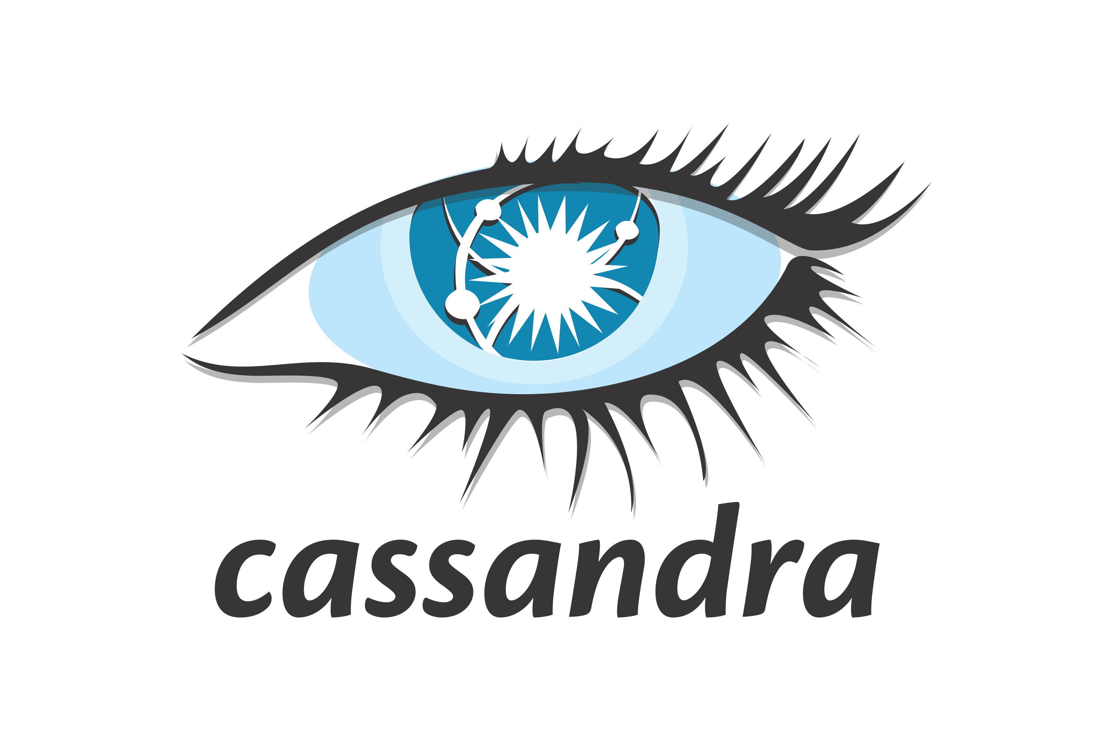


Other NoSQL DB types
Full text search engines
For searching in text documents, indexing web
Wide-column databases
Like SQL, but each row can contain thousands of cells. Joins are either not supported, or work very slowly
Time series databases
For storing data-timestamp values. For example, for metrics or smart thermometers

Slide 12
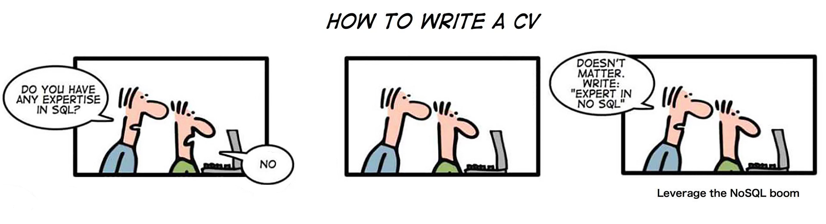
Will SQL databases die?

Slide 13
QA
Do you have any questions?

